Slide 1

JavaScript Essentials
Course Overview
SoftUni Team
Technical Trainers
Software University
http://softuni.bg

Slide 2
Table of Content
Introduction
Training & Team
Course Objectives
Course Organization

Slide 3
Have a Question?
sli.do
#js-core

Slide 4












SoftUni Diamond Partners

Slide 5




SoftUni Organizational Partners

Slide 6

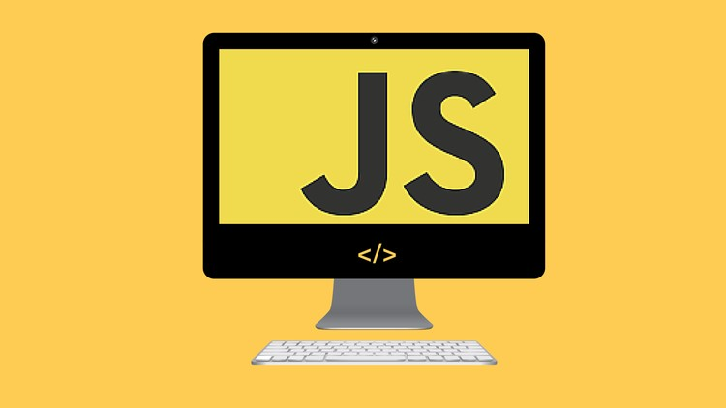
JS Essentials
Course Objectives & Program

Slide 7

JS Essentials - Course Topics
Syntax, Functions and Statements - Basic syntax, Conditional Statements, Functions and Advanced functions
Objects and DOM - Objects, JSON, Document Object Model, DOM Elements, DOM Manipulations, DOM Events

Slide 8

JS Essentials - Course Topics (2)
3. Arrays and Matrices - Arrays and Multi-Dimensional Array
4. Strings and RegExp - Strings and Regular Expressions

Slide 9

Trainers and Team

Slide 10
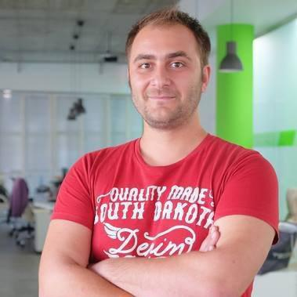
Doncho Minkov
Senior Full-Stack Developer in SoftUni
+10 year in IT - 8+ years experience as Technical Trailer @ Telerik Academy
Fluent in Node.js, .NET, Angular, Java, C++
Experience with all popular mobile platforms (Android, iOS, Windows)
"30 under 30" - Forbes 2017 - Education
Front-end Developer by heart
Software Developer by need
@SoftUni mostly working with React & ASP.Net Core

Slide 11
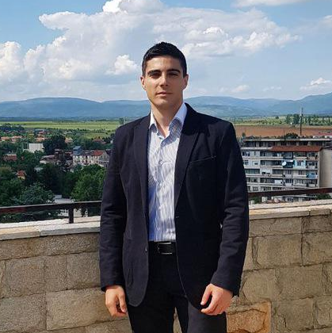
William Abboud
Full Stack & Senior Front-End Developer @ SoftUni
Studied Computer Science in Newcastle University
Passionate about Front-End Technologies (HTML/CSS/JS/React.js) and UX/UI Design

Slide 12
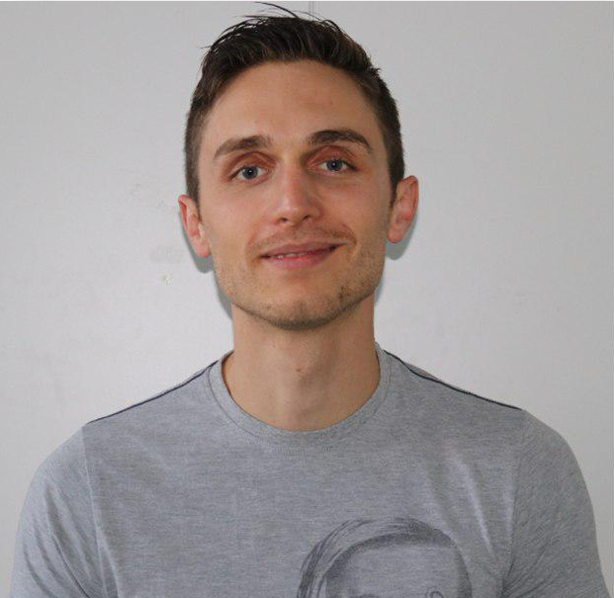
Ivaylo Dimitrov
5+ years experience in the IT (HTML, CSS, JavaScript, C#, SQL, Windows Server)
Excellent Software University student
Technical Trainer in Software University

Slide 13

Behind the Scenes
The team working on the materials:
Antoniya Atanasova
Bilyana Borislavova
Hristomir Asenov
Kiril Kirilov
Tanya Staneva

Slide 14

Course Objectives
Course Details and Schedule

Slide 15
Targets of the Course
Learn the basic syntax in JavaScript
Learn how to work with data types (string, number, object, etc.) and statements
Learn how to use functions and separate the different logic
Learn how to represent real objects in code
Learn to work with Document Object Model

Slide 16

Exam
Structure: 3 problems for 4 hours
Problems description:
Syntax, Simple Calculations and Operations
Arrays / Matrices
Objects and DOM
https://judge.softuni.bg/Contests/1659/JS-Essentials-Exam- Preparation-May-2019

Slide 17

Course Organization

Slide 18

Structure of the course
Lectures:
Twice a week (4 hours each) in Tech + Knowledge Hall
Tuesday and Friday (18:00 - 22:00)
Learn new material
Exercises:
Twice a week (4 hours each) in Experience Hall
Monday and Thursday (13:30 - 17:30)
Practice learned material
Ask questions if any

Slide 19

Evaluation Criteria
Mandatory
Final exam - 95%
Exercises/Homework - 5%
Bonuses:
Presence in class – 5% bonus (onsite students only)

Slide 20
https://softuni.bg/courses/js-essentials

Slide 21




Trainings @ Software University (SoftUni)
Software University – High-Quality Education and Employment Opportunities
softuni.bg
Software University Foundation
http://softuni.foundation/
Software University @ Facebook
facebook.com/SoftwareUniversity
Software University Forums
forum.softuni.bg

Slide 22

License
This course (slides, examples, demos, videos, homework, etc.) is licensed under the "Creative Commons Attribution-NonCommercial-ShareAlike 4.0 International" license

